Slide 1
Never-Ending Language Learning (NELL)
Jacqueline DeLorie

Slide 2
What is NELL?
An independent and never-ending machine semi-supervised learning system.
Semi-supervised – “seed data” + unlabeled items
A knowledge base of information built by reading the web.
Categorizations and relation functions.
Fruit(Apple).
LocatedIn(Boston, Massachusetts)
!Fruit(Carrot)
Notes:
Semi-supervised – “seed data” + unlabeled items

Slide 3
What is NELL’s Goal?
Answer questions posed by humans with no human intervention.
Learn better over time, with little to no human interaction.
Given what we have extracted today, learn to find facts and map them to categories better.

Slide 4
Who made NELL?
A research group at Carnegie Mellon University
Lead by Professor Tom Mitchell
Launched in January 2010
Sponsors: DARPA, NSF, Google, Yahoo!
Uses the ClueWeb09 toolkit to parse neatly formatted webpages.
~500 Million webpages.

Slide 5
How Does NELL Work?
Given an ontology, along with a few examples for each category (seed examples).
Read the web, extract facts and map them to the ontology.
Uses “bootstrapping”, train predictors using “seed” data, labels using predictors, trains predictors based on new labels, etc.
Errors propagate causing a shift.
Use combinations of predicates and negations of predicates to avoid.
Notes:
Smarter parsing in comparison to ‘is a’
Ontology – collection of unary and binary predicates ( a.k.a, categories and relations respectively).

Slide 6
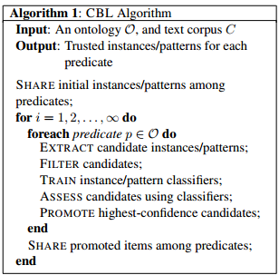
Ontology
NP(C) – set of valid nouns in corpus
Patt(C) – set of valid category patterns in corpus
NPr(C) - set of valid relations in corpus
Pattr(C) - set of valid relation patterns in corpus
Notes:
Coupled Bootstrap Learner

Slide 7
Results
6 Months after launch:
For ¾ of relations and categories, 90-99% accuracy.
For 1/4 of relations and categories, 25-60% accuracy.
After that, weekly sessions held for human review of labels, intervening when blatant errors arose.
Now, anyone can interact via NELL’s website:
http://rtw.ml.cmu.edu/rtw/

Slide 8
References
http://rtw.ml.cmu.edu/rtw/
http://www.cmu.edu/homepage/computing/2010/fall/nell-computer-that-learns.shtml
http://en.wikipedia.org/wiki/Never-Ending_Language_Learning
http://en.wikipedia.org/wiki/Semi-supervised_learning
http://rtw.ml.cmu.edu/papers/cbl-sslnlp09.pdf

